Slide 1


Poem
Appreciation & Writing
诗歌欣赏与写作

Slide 2
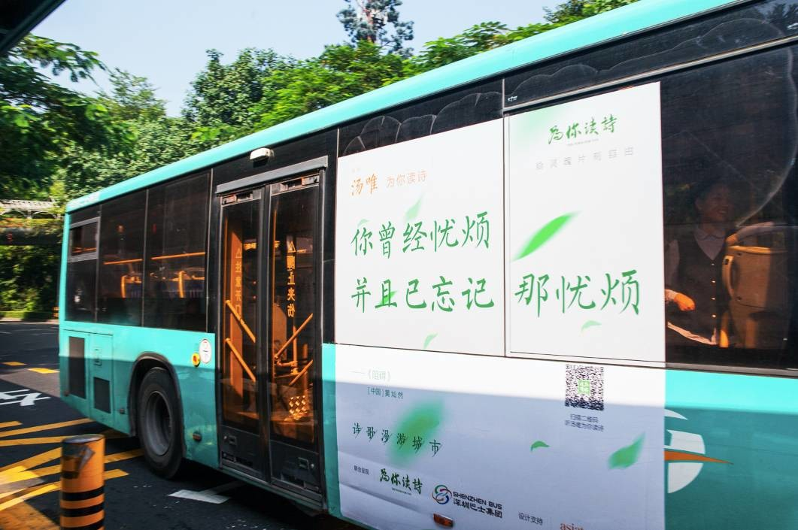
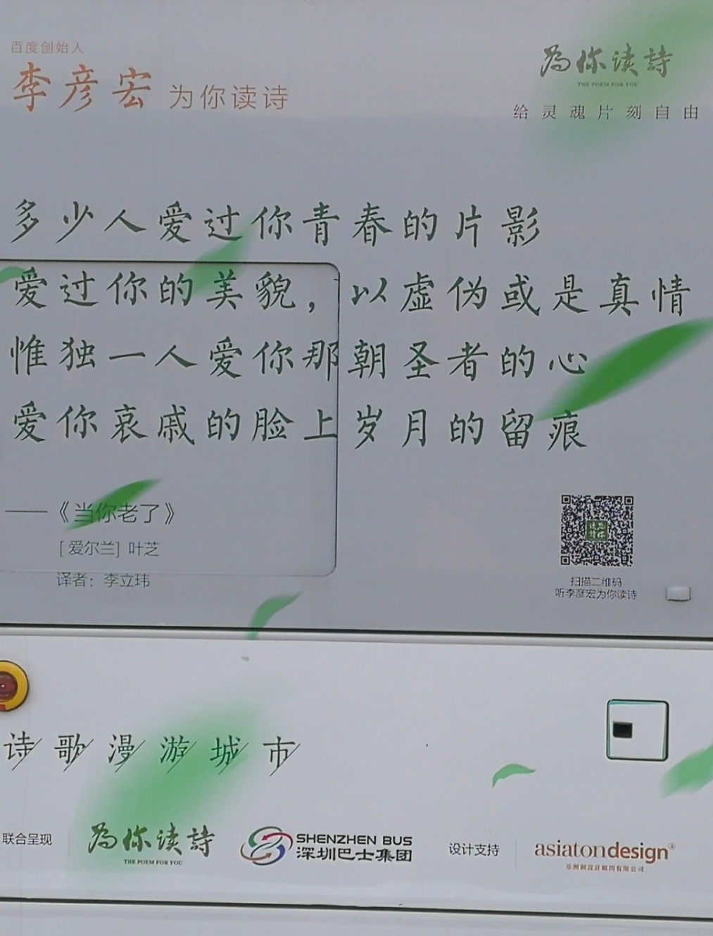

When you are old

Slide 3
Analysis：
When You Are Old (1)
----WILLIAM BUTLER YEATS
/i:p/
When you are old and gray and full of sleep
And nodding by the fire, take down this book,
当你老了，白发苍苍，睡意朦胧， 在炉前打盹，请取下这本诗篇， And slowly read, and dream of the soft look Your eyes had once, and of their shadows deep；
慢慢吟诵，梦见你当年的双眼 那柔美的光芒与青幽的晕影；
/uk/
Notes:
3

Slide 4
Analysis：
When You Are Old (2)
----WILLIAM BUTLER YEATS
“Love” is repeated for 5 times
How many loved your moments of glad grace, And loved your beauty with love false or true；多少人爱你青春欢畅的时辰 爱慕你的美丽，假意或真心， But one man loved the pilgrim soul in you, And loved the sorrows of your changing face;只有一个人爱你那朝圣者的灵魂， 爱你衰老了脸上的痛苦的皱纹。
Make a contrast between two kind of persons
pilgrim: A religious devotee who journeys to a shrine or sacred place.朝圣者，朝觐者：旅行到神殿或圣地去的宗教虔诚者

Slide 5
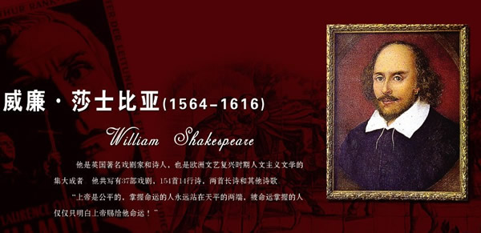
Sonnet 18
William Shakespeare
Shall I compare thee to a summer’s day,
Thou art more lovely and temperate.

Slide 6
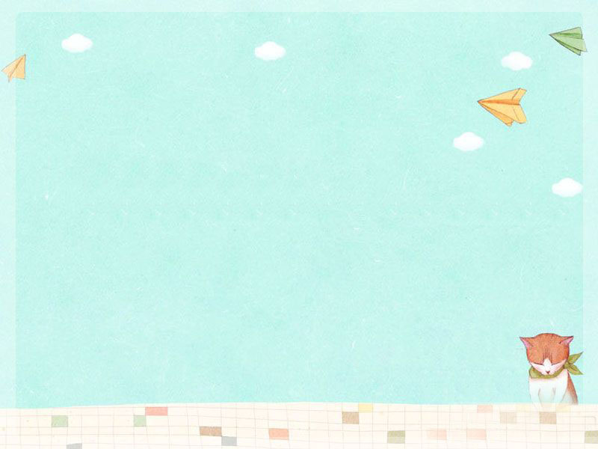

Cinquain
A style of five-line poem.
Cinquain is a five-line poem, which can give a clear picture and create a special feeling using a few words.

Slide 7


Appreciating Time
Brother
Beautiful, athletic
Teasing, shouting, laughing
Friend and enemy too
Mine
Summer
Sleepy, salty
Drying, drooping, dreading
Week in, week out
Endless

Slide 8
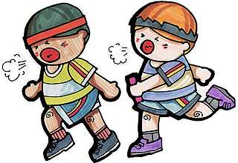
Structures of Cinquain
Brother
Beautiful ,athletic
Teasing, shouting ,laughing
Friend and enemy too
mine
---one word (topic)
---two adjs
---three verbs with –ing
---four words
---one word

Slide 9

Writing Time
Try to write a cinquain together.
Look at some pictures and think about
what you want to write about.

Slide 10

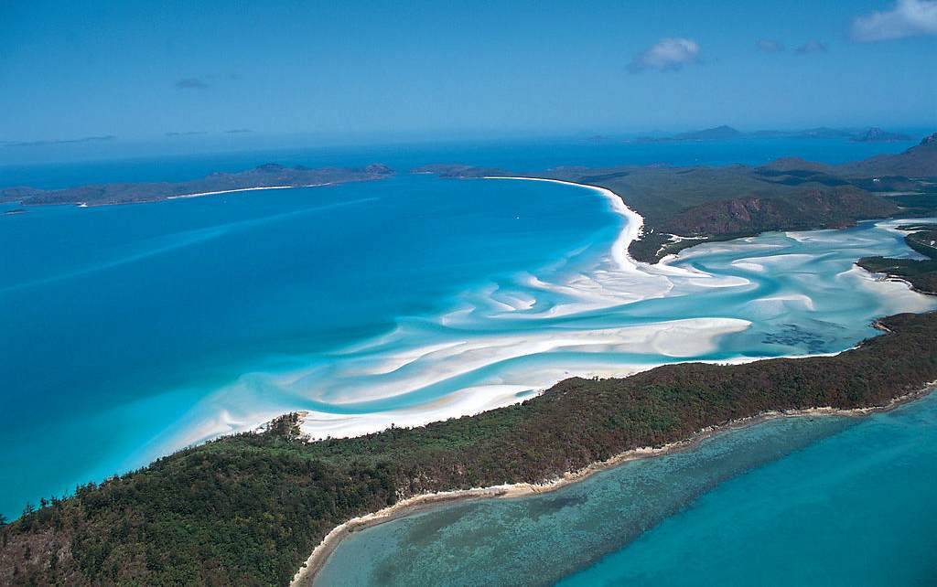
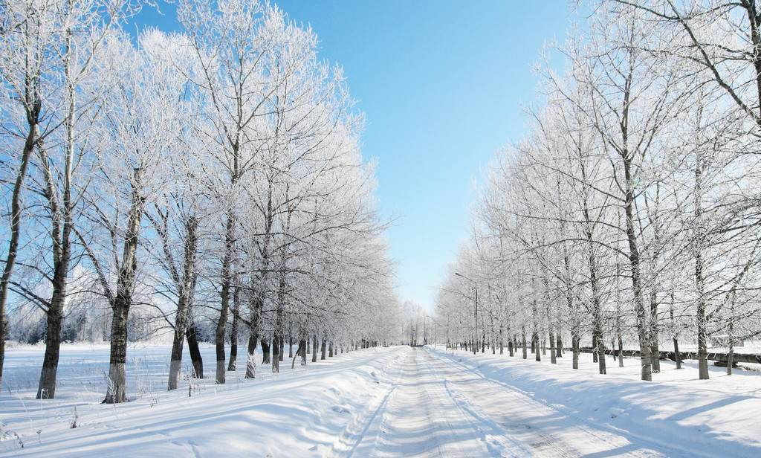
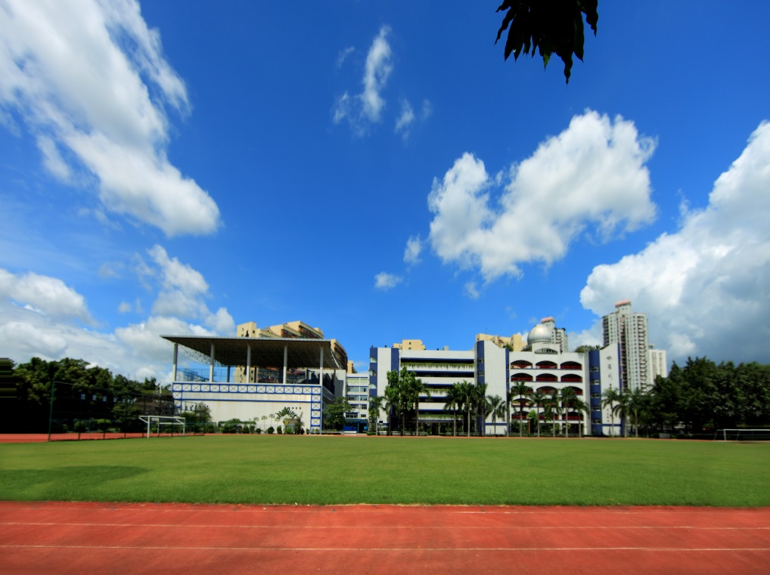
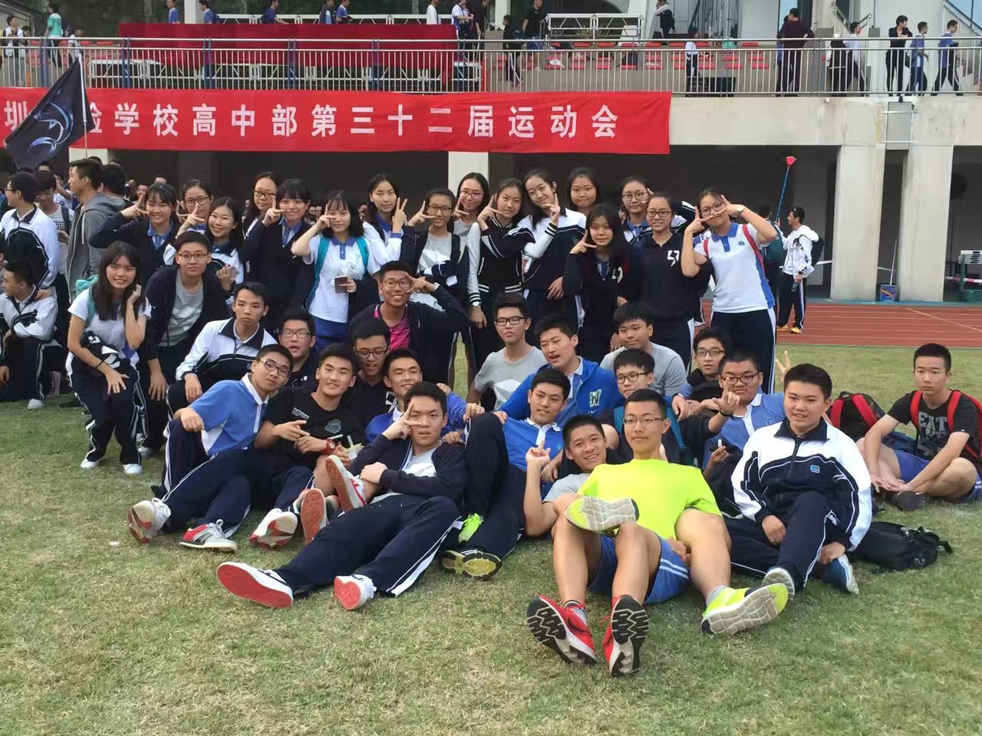
sea
winter
SZSY
Class 9

Slide 11

Show Time
Show and read your cinquains on the stage.

Slide 12
List poems
Poems that list things
List poems have a flexible line length and repeated phrases which give both a pattern and a rhythm to the poem.

Slide 13

Our first football match
We would have won…
if Jack had just scored that goal,
if we’d had just a few more minutes,
if we had trained harder,
if Ben had passed the ball to Joe,
if we’d had thousands of fans screaming,
if I hadn’t taken my eye off the ball,
if we hadn’t stayed up so late the night before,
if we hadn’t taken it easy,
if we hadn’t run out of energy,
We would have won…
if we’ve been better!

Slide 14
Version 1:
I would have done better in the exam,
if I had____________________________,
if I had____________________________,
…
…
Version 2:
If I were a boy/girl
I would____________________________,
I would____________________________,
…
…
Version 3:
If I were a big tree, I would grow so tall that I’d touch the sky.
If I were a butterfly, I would……
If I were a …… , I would ……
…
…

Slide 15
Homework
Write a cinquain about Christmas
Notes:
此处单击右下人人重庆图片可连接到另一pps文件，有几张关于重庆的图片播放

Slide 16

Thank you!
Good bye!

